Slide 1
HACKATHON PROJECT
Shared Memory Based
Data Exchange System
Process communication • Synchronization • Data consistency
Team No: 8 | Section: 8
B. Pranavi
2520030026
T. Hansini
2520030095
V. Charishma
2520030140
Guide: Dr. Muniraju Naidu

Slide 2
1
Problem Statement
1
2
3
Fast exchange
Race conditions
Need for control
Multiple processes need to exchange information quickly.
Simultaneous updates can cause race conditions or inconsistent data.
A shared communication area and synchronization are needed.

Slide 3
2
Project Objectives
1
Create a shared memory region accessible to multiple processes.
2
Allow one process to write a message and another process to read it.
3
Protect shared data using a process-shared semaphore.
4
Provide a simple Python web dashboard.

Slide 4
3
Technologies Used
C language
Shared-memory operations
1
System V shared memory
shmget(), shmat(), shmdt(), shmctl()
2
POSIX semaphore
sem_init(), sem_wait(), sem_post()
3
Python HTTP server
Standard-library server for the local dashboard
4
GCC compiler
Ubuntu / WSL environment
5

Slide 5
4
System Architecture
1
2
3
4
Writer process
›
Shared memory
›
Reader process
›
Dashboard
Obtains the semaphore lock and updates shared data.
Stores the latest message, version, writer PID, and timestamp.
Uses the same lock to read a consistent snapshot.
Calls the C writer and provides a browser-based input form.

Slide 6
5
How Shared Memory Works
The operating system creates a memory segment that multiple processes attach to.
Process A
1
Process A
↕
Processes access the same memory area instead of sending separate copies.
2
Shared memory
segment
Shared memory is fast, but concurrent access must be controlled.
3
↕
This project stores the latest message in a shared structure.
4
Process B

Slide 7
6
Consistency Using a Semaphore
sem_wait()
Think of the semaphore as one key for a shared room.
1
Locks access before reading or writing.
Update
2
The process updates the message and metadata while holding the lock.
sem_post()
3
Releases the lock for the next process.

Slide 8
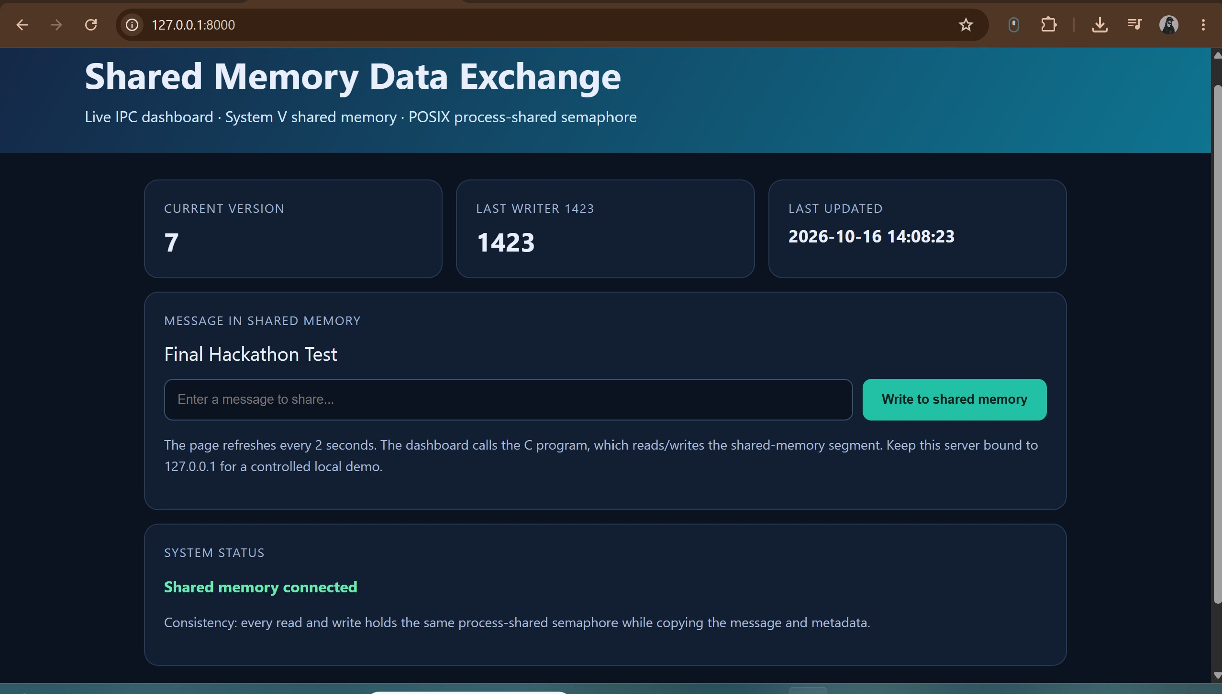
7
Python Dashboard
A local browser page provides a message input form.
1
The dashboard invokes the C program to write the submitted message.
2
A separate reader command verifies the stored message.
3
Open http://127.0.0.1:8000 while dashboard.py is running.
4
Live dashboard at 127.0.0.1:8000

Slide 9
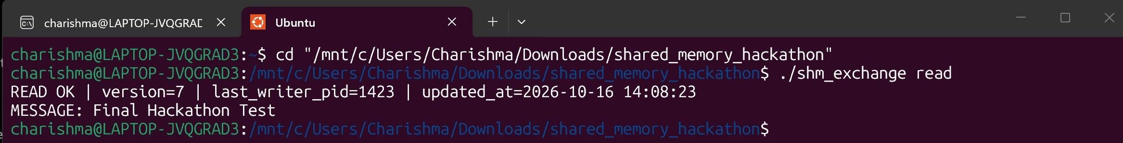
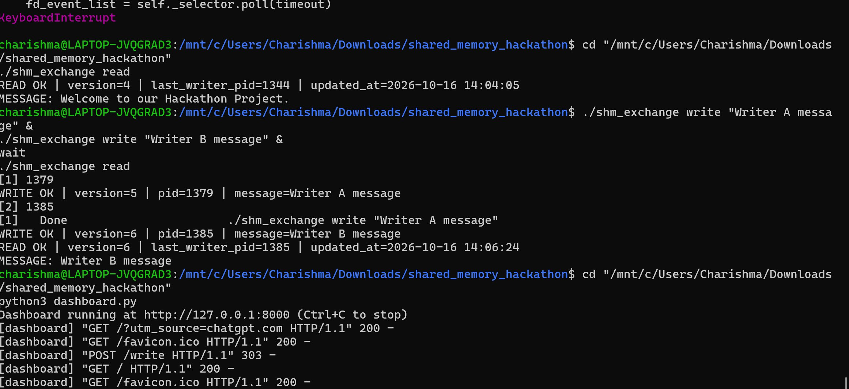
8
Testing and Observed Results
Compiled the C source successfully with GCC.
1
Reader terminal: ./shm_exchange read → version 7
Initialized shared memory and tested write/read commands.
2
Two concurrent writers completed and the version number advanced.
3
Submitted “Final Hackathon Test” in the dashboard and read it in a second terminal.
4

Slide 10
9
Limitations and Future Work
Limitations
Future work
1
Only the latest message is stored; it is not a message queue.
Message queue
Access control
2
The local demo has no authentication and is intended for controlled testing.
Logs
Multiple clients
3
A crash while holding the semaphore may need recovery handling.
Crash recovery

Slide 11
10
Conclusion
1
2
3
4
The project demonstrates inter-process communication using shared memory.
A process-shared semaphore protects updates and helps maintain consistency.
The dashboard provides a simple way to send data for another process to read.
Local tests demonstrated message exchange and concurrent-writer behavior.

Slide 12
Thank You
Questions?
Team 8 | B. Pranavi • T. Hansini • V. Charishma | Guide: Dr. Muniraju Naidu

